Slide 1
A reverse form of welfarism: some reflections on Australian housing policy
Keith Jacobs
Housing and Community Research Unit
University of Tasmania

Slide 2
The Australian housing system
Viewing the Australian housing system as dysfunctional is a category error.
The system is a hugely successful vehicle for the wealthy to increase their capital.
Housing shortages necessary to maintain the value of property and ensure that greater profits can be extracted.

Slide 3
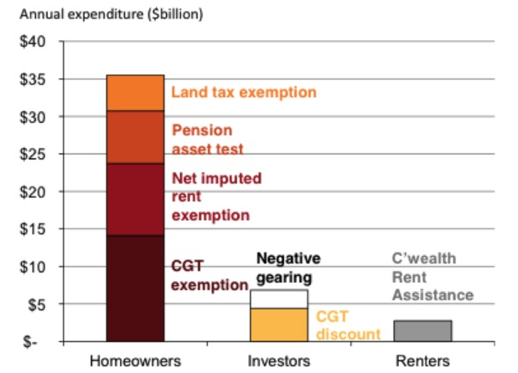
Annual government expenditure on housing policy (Kelly, et al. 2013)

Slide 4
Overview
Stress in the private rental sector a symptom of systemic inequality.
Why has the ‘social’ become so tarnished and what does this reveal?
Neoliberalism and end of the post-war consensus.
Role of government in promoting housing commodification and the narratives surrounding housing.
The social and economic consequences of contemporary housing policy.
Implications of the ‘renter nation’

Slide 5
The long view
Tendency in research to frame housing policy naively—as a benevolent or altruistic undertaking.
Interpretations of housing policy require a more nuanced interpretation that foregrounds ideological and political contestation amongst key interest groups.

Slide 6
Housing and social policy research
Propagates an evolutionary modernization thesis framework where policy is decoupled from broad shifts in capitalism’ (Hodkinson et al 2013: 5).
Leads to research that downplays conflict and bland forms of positivist inquiries for government agencies.

Slide 7
The death of the post-war social project?
Period from the late 1940s to the 1970s can be viewed as period of accommodation between the interests of capital and labour.
Public housing, health provision and education formed part of the social contract. ‘Up until the 1980s, homeownership seen as a store of wealth but was not generally perceived as a source of income’ (Forrest and Hirayama 2014:3).
Ruggie ( 1997:5) ‘a grand domestic bargain [in which] societies were asked to embrace the change and dislocation attending international liberalisation but the state promised to cushion those effects by means of its newly acquired domestic and social policy roles’.

Slide 8
The age of anxiety
The age of anxiety – ‘we have entered an age of insecurity – economic insecurity, physical insecurity, political insecurity.. Insecurity breeds fear. And fear – fear of change, fear of decline and fear of strangers and an unfamiliar world – is corroding the trust and interdependence on which civil societies rest’ (Judt 2010).

Slide 9
Understanding housing policy
‘Ambulance’ and ‘service counter’ conceptions
Punishing the poor – the state ‘produces inequality and marginality upstream, before it manages them downstream’ (Wacquant 2013).
The state practices laissez-faire at the top, at the level of circulation of capital and production of inequality, but it turns interventionist and intrusive when it comes to managing the consequences of inequality at the bottom, for the life spaces and life chances of the precarious fractions of the post-industrial working class’ (Wacquant 2013).

Slide 10
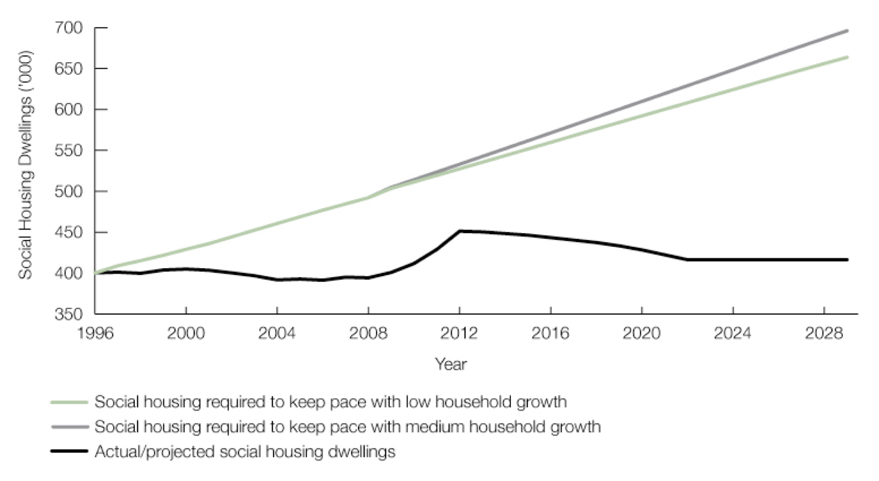
The failure of government to provide low cost housing for rent

Slide 11
Understanding marginality
Splintering urbanism (Graham and Marvin 2001) ‘Ghost wards’ and ‘dual cities’
Wacquant (1999) - advanced marginality, ‘city as a site and fount of novel forms of exclusionary social closure’.
Neoliberalism not a proposal for state retrenchment but a political project.
‘Centaur like’ - expands freedom at the top end and ‘punishment’ at the bottom end.

Slide 12
Neoliberalism not a causal deus ex machina operating independently of human agency.
Speculative forms of capitalism has broken the link between the home as a place of shelter. It is now a commodity to be bought and sold like other products.

Slide 13
Public housing
Public housing stands in the way of a wider political project to commodify welfare provision.
Therefore needs to be seen as a failure to disparage any notion that there is a viable alternative to homeownership.

Slide 14
Private rental housing
A misnomer – PR market relies on taxpayers subsidies to boost the profits of landlords.
CRA amounts to $3.6 billion per annum and is received by 1.2m households to pay their rent.
Inputted tax subsidies to investors around $5.4 billion per annum (Yates 2008).
Artificial scarcity (Harvey 1974) established by landlords and developers to maximise profit – leads to a crisis e.g. rising prices or housing bubbles.

Slide 15
The myth of the ‘mum and dad’ landlord
1.9 million individuals who declare income from rental properties
Housing Industry Association claim that 75% of investors earn $80k or less.
BUT 60% of investment housing debt held by top 20% of income earners. (source Janda 2014)

Slide 16
Why commodify housing?
Bulwark for democracy!
Owner occupied and investor dwellings perform as a wealth producing asset.
Confers a sense of social order and societal hierarchy that is necessary for the workings of capitalism. ‘Dream’ of homeownership is a narrative construction rather than anything primordial or innate.
Notion of the responsible homeowner/investor furnaces a powerful imaginary in relation to modern identity (Glynos 2011).
By framing homeownership and landlordism as a pathway to achieve personal success, governments provide a steer away from collective modes of sociality.

Slide 17
Source: Getty Images

Slide 18
The ‘Renter nation’: consequences
Contemporary housing system can be viewed as both a symptom and cause of social inequality
The layout and composition of cities.
Urban sprawl, squalor in the private rental sector.
Encourages us to act more instrumentally by prioritising wealth-creation activities over and above collective endeavours.
The home/investor property now used as collateral to borrow against and leverage investment (accentuating inequality).

Slide 19
The modern city
Gated communities
Privatisation and the erosion of public spaces
Exploitation in the low income rental market
New forms of insecurity, security guards, privatised shopping malls CCTV
But self defeating? The allure of security through private forms of habitation results in more insecurity and fear.
Privatisation emblematic of the erosion of sociality and neighbourhood bonds.

Slide 20
The future?
What has happened to social housing provides a foretaste of what we can expect for remaining forms of welfare provision (education, health, social services, aged care).
Private sector will increasingly be the only option for all but the very well off.

Slide 21
Conclusions - Government policy
Government actively promoting housing as an investment good through generous tax arrangements which has accentuated the crisis
Marginal private rental sector likely to become a permanent feature of the housing crisis.

Slide 22
References
Aalbers, M. and Christophers, B. (2014) Centring housing in political economy’ Housing, Theory and Society (on line version in advance of print) p 1-22.
Forrest, R. and Hirayama, Y. (2014) ‘The financialisation of the social project: embedded liberalism, neoliberalism and homeownership’ Urban Studies, Online 1-12
Glynos, J. (2011) “Fantasy and Identity in Critical Political Theory.” Filozofski Vestnik 32(2): 65–88.
Harvey, D. (1974) Class monopoly rent, finance capital and the urban revolution, Regional Studies 8 (3) 239-255.
Harvey, D. (2010) The Enigma of Capital, London: Profile.
Hodkinson S; Watt, P., Mooney, G. (2013) “Introduction: neoliberal housing policy - time for a critical re-appraisal.” Critical Social Policy 33 (1): 3-16.
Janda, M. (2014) The myth of ‘mum and dad property investors’ ABC The Drum
http://www.abc.net.au/news/2014-09-24/janda-the-myth-of-mum-and-dad-negative-gearers/5766724
Judt, T. (2010) Ill Fares the Land, London: Penguin.
Kelly, J., Hunter, J., Harrison, C., Donegan, P. (2013), Renovating Housing Policy, Grattan Institute, Melbourne..
Ruggie, J. (1997) ‘Globalization and the embedded liberalism compromise: the end of an era’ Working paper 97/1 , Max Planck Institute for the Study of Societies, Cologne Germany.
Yates, J. (2008) ‘Australia’s housing affordability crisis’, Australian Economic Review, 41 (2), 200–214.

